Slide 1
Applying Roofline to KNL
By THIRTY

Slide 2
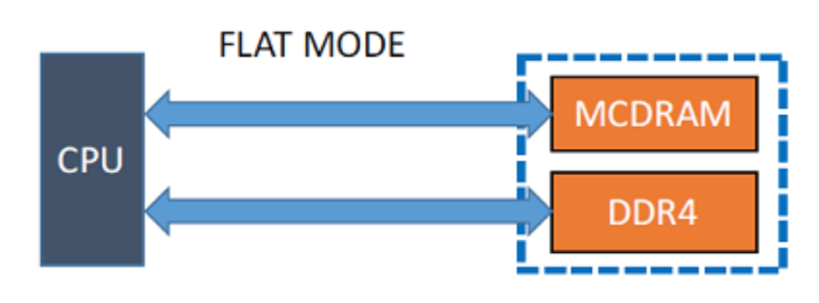
KNL Memory Mode
Flat Mode
MCDRAM을 메모리로 사용
소프트웨어 설계 비용 증가
memkind, numactl 라이브러리 활용
메모리 최대용량 확장 효과

Slide 3
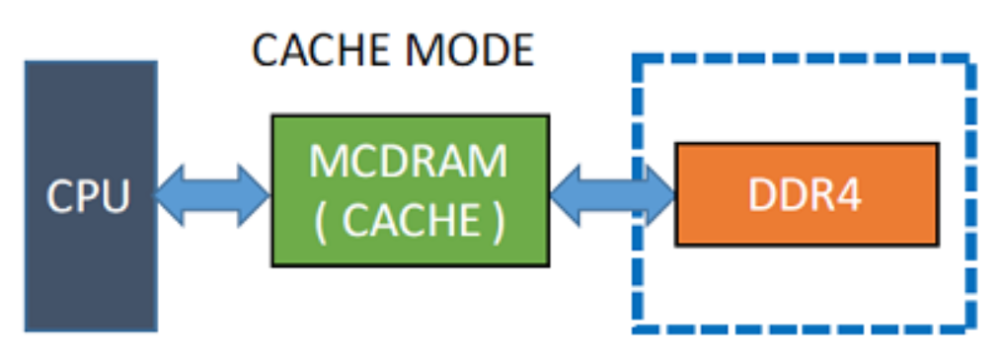
KNL Memory Mode
Cache Mode
MCDRAM을 캐시로 사용
소프트웨어 독립성 유지
L3캐시로 directed mapped associativity 방법 사용
캐시 미스 발생시 DDR보다 성능이 떨어짐

Slide 4
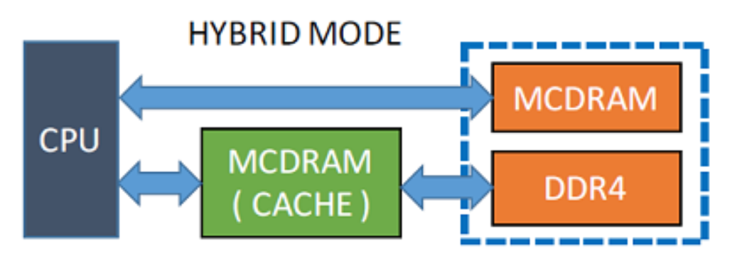
KNL Memory Mode
Hybrid Mode
Flat 모드와 Cache모드를 합친 개념
비율에 따라 25% 50% 75% 등 달라짐

Slide 5
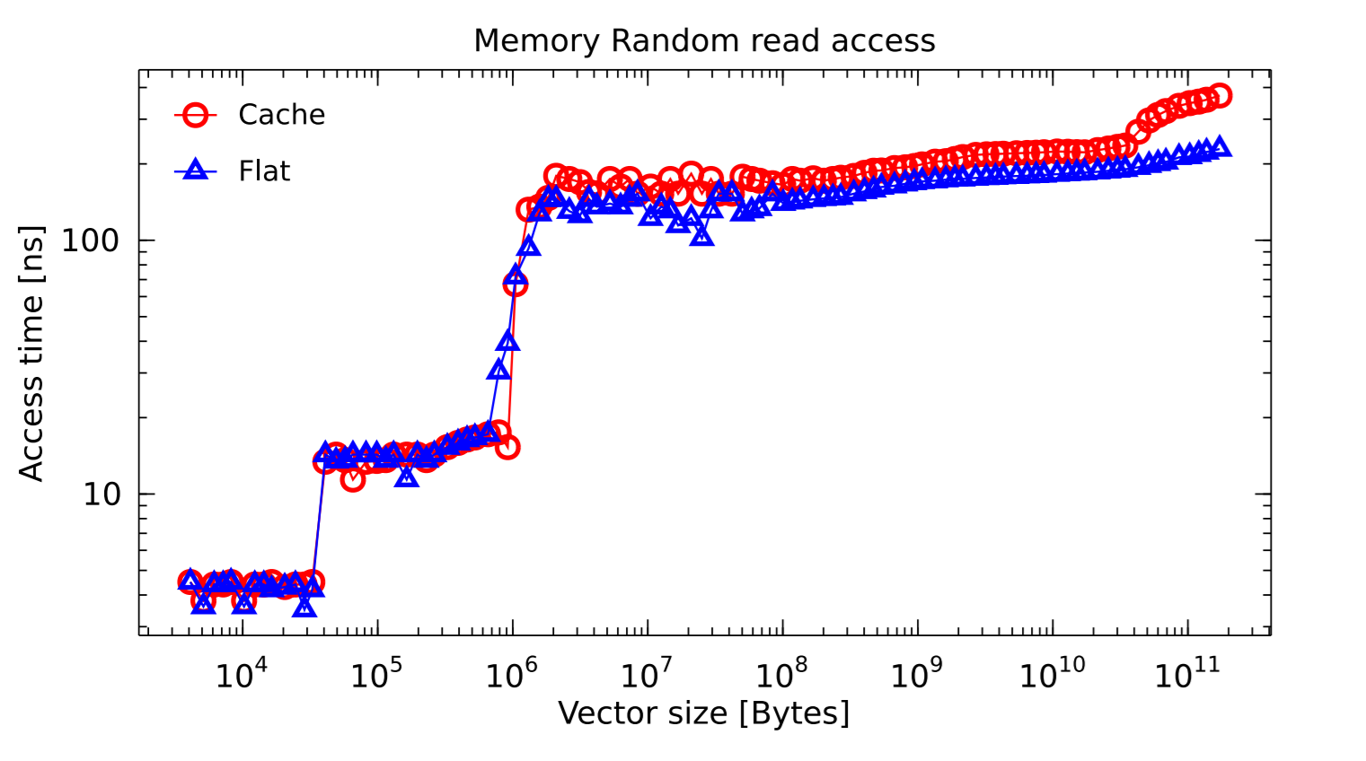
KNL Memory Mode
Access Time
Cache Coherence
Cache Miss

Slide 6
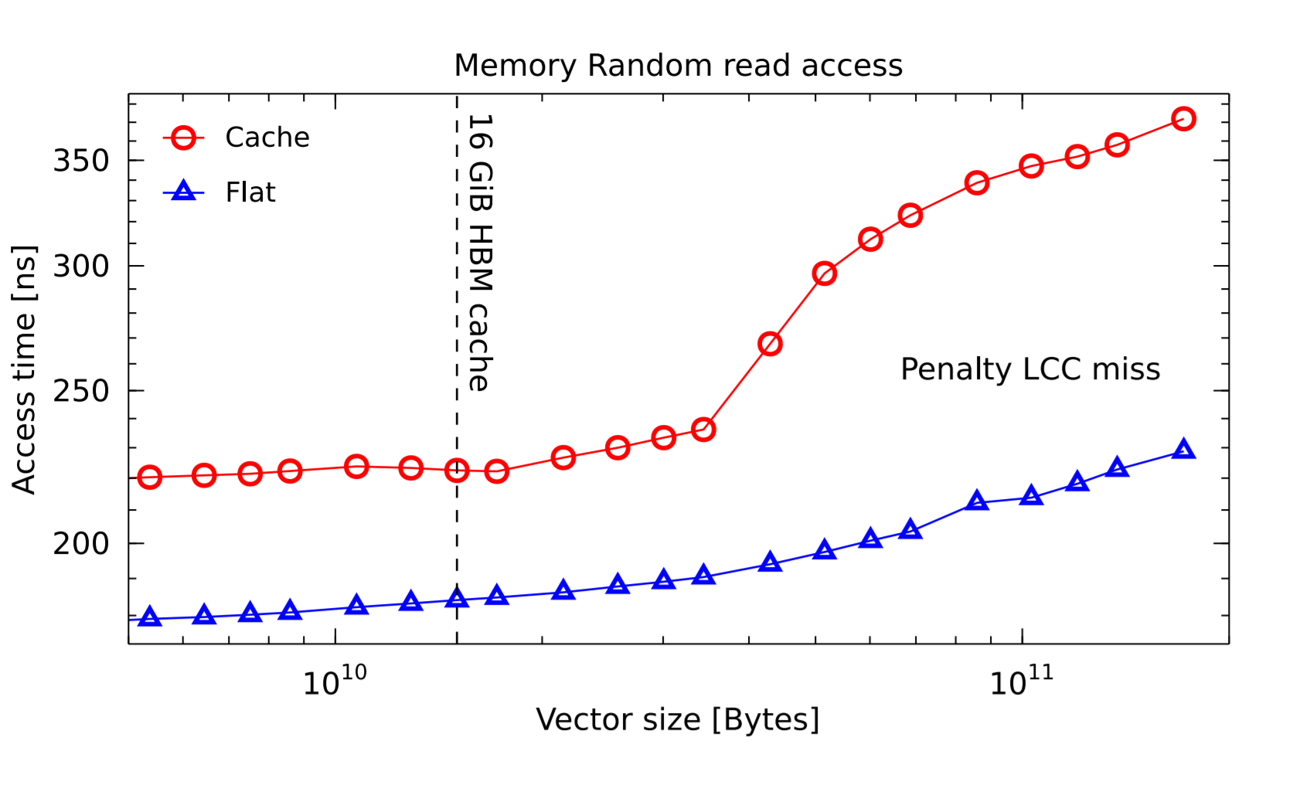
KNL Memory Mode
Access Time
Max

Slide 7
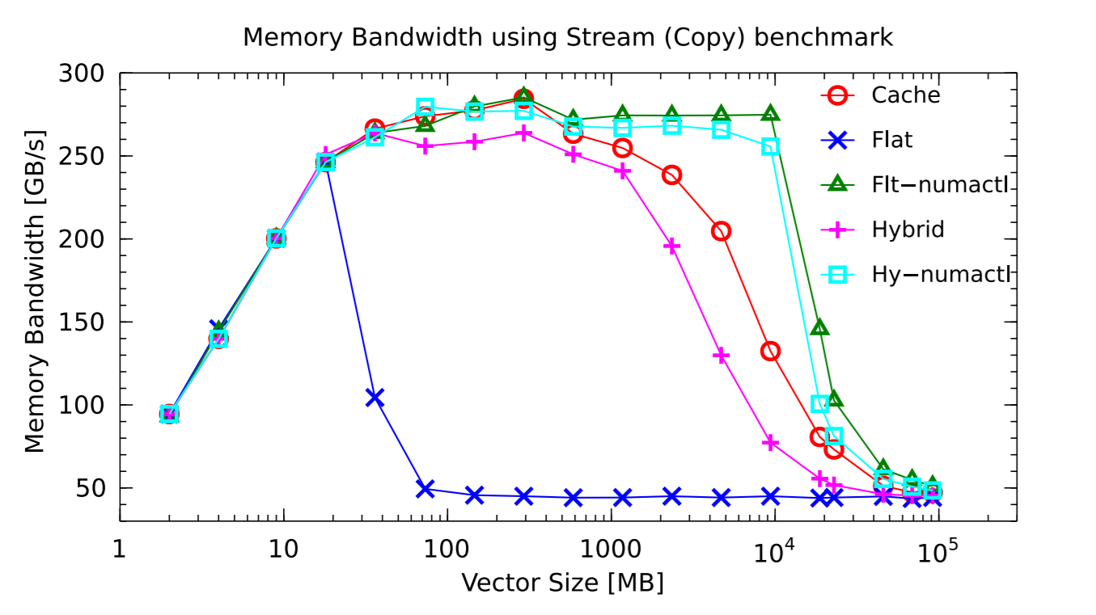
KNL Memory Mode
Bandwidth

Slide 8
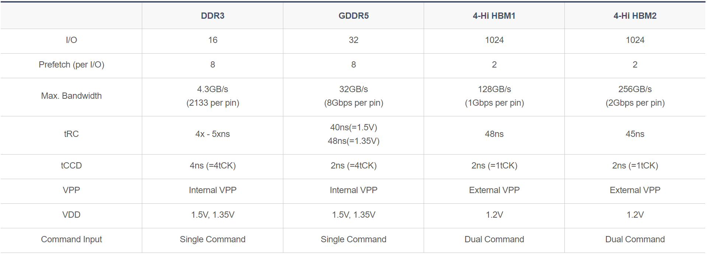
KNL Memory Mode
Bandwidth

Slide 9
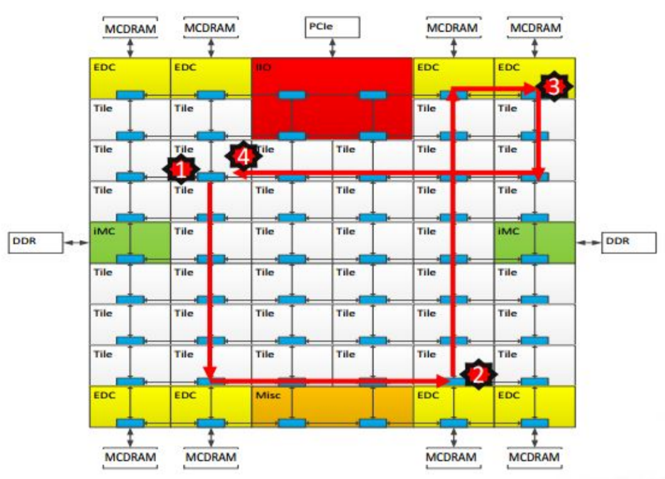
KNL Cluster Mode
All to All
L2 miss encountered
Send request to the distributed directory
Miss in the directory. Forward to memory
Memory sends the data to the requestor

Slide 10
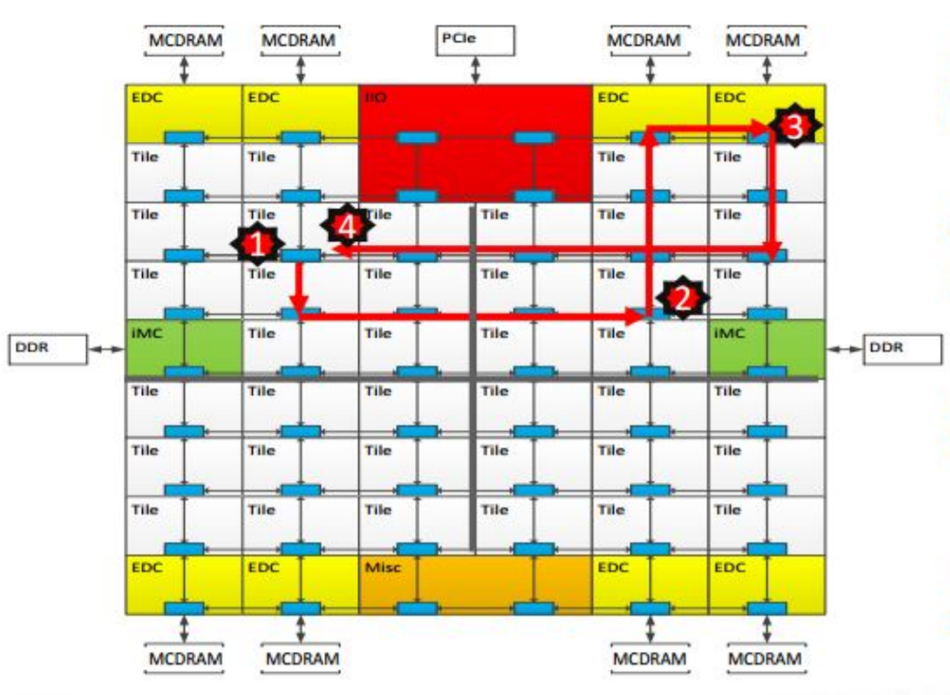
KNL Cluster Mode
Quadrant
L2 miss encountered
Send request to the distributed directory
Miss in the directory. Forward to memory
Memory sends the data to the requestor

Slide 11
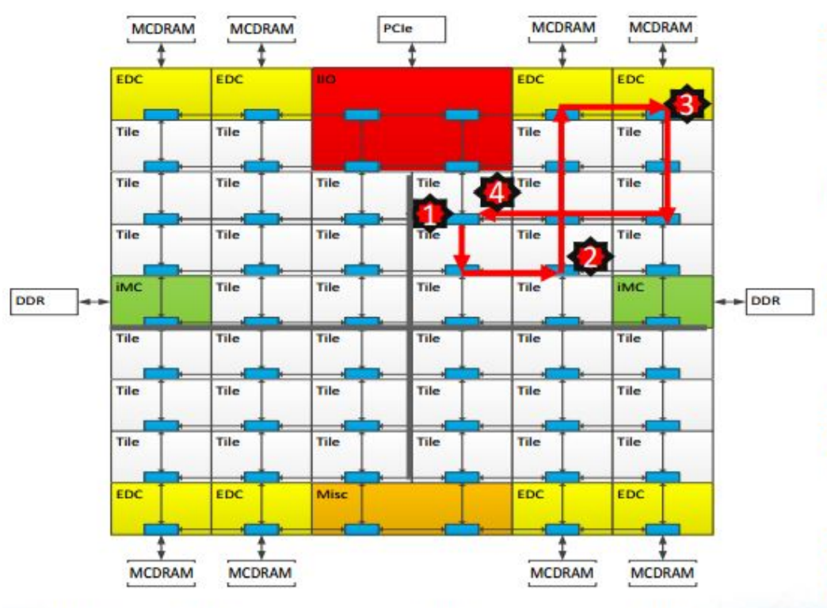
KNL Cluster Mode
Sub-NUMA
L2 miss encountered
Send request to the distributed directory
Miss in the directory. Forward to memory
Memory sends the data to the requestor

Slide 12
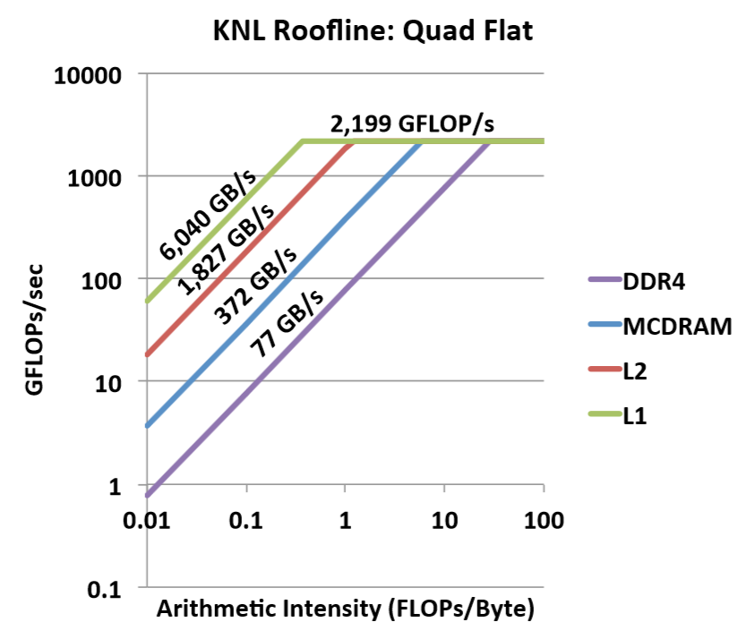
Review - Tools and Methods
Empirical Roofline Tookit (ERT)
To measure the maximum sustained bandwith at each of the cache hierarchy
https://bitbucket.org/berkeleylab/cs-roofline-toolkit
https://crd.lbl.gov/departments/computer-science/PAR/research/roofline/

Slide 13
Review - Tools and Methods
numactl
Numactl runs processes with a specific NUMA scheduling or memory placement policy

Slide 14
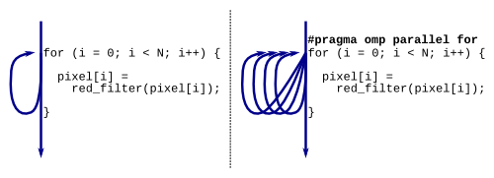
Review - Tools and Methods
OpenMP
OpenMP provides a second level of parallelization

Slide 15
Review - Tools and Methods
Intel Software Development Emulator (SDE)
To count the number of floating-point operations

Slide 16
Review - Tools and Methods
Intel Vtune Amplifier
To measure data movement at both the DDR and MCDRAM momory interfaces

Slide 17
Review - Kernels
WARP-PICSAR

Slide 18
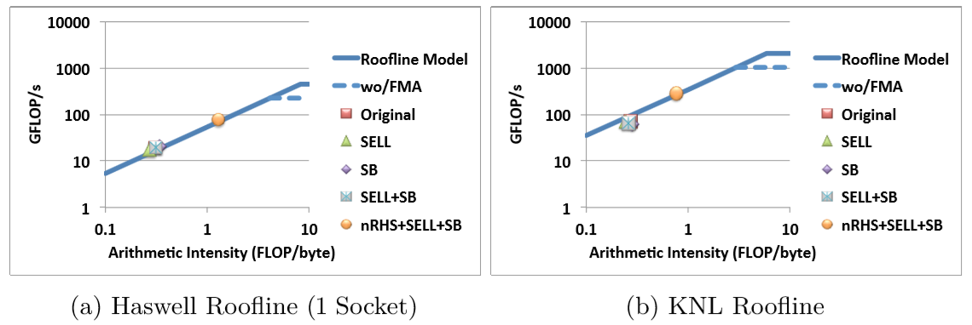
Review - Kernels
EMGeo

Slide 19
Review - Kernels
MFDn

Slide 20
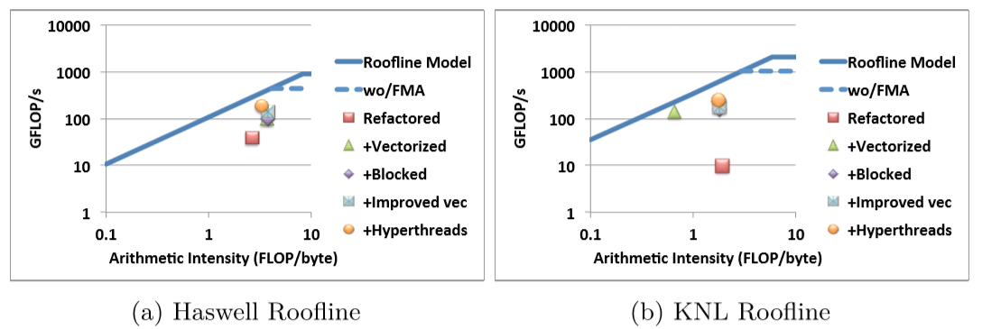
Review - Kernels
BerkeleyGW

